Slide 1
WEB-SEARCH ENGINE
COMP8547 – Advanced Computing Concepts Final Project
Section – 2
Team – 2 - TETRAGON

Slide 2
Roles and responsibilities
Navjot Makkar (110100116) | Web Crawling, HTML to Text Converter and Dictionary Creation
Utsav Krishnatra (110095341) | Search Word and Page Ranking
Akshit Bhatia (110093528) | Spell Checking and Word Suggestion
Gagan Singh Golar (110096290) | Frequency Counter and History Generation

Slide 3
What is Web Search engine?
Tool that helps users find information on the web
Uses algorithms to crawl, index, and rank web pages.
Find websites, images, videos, news, and more.
Integral part of modern-day life

Slide 4
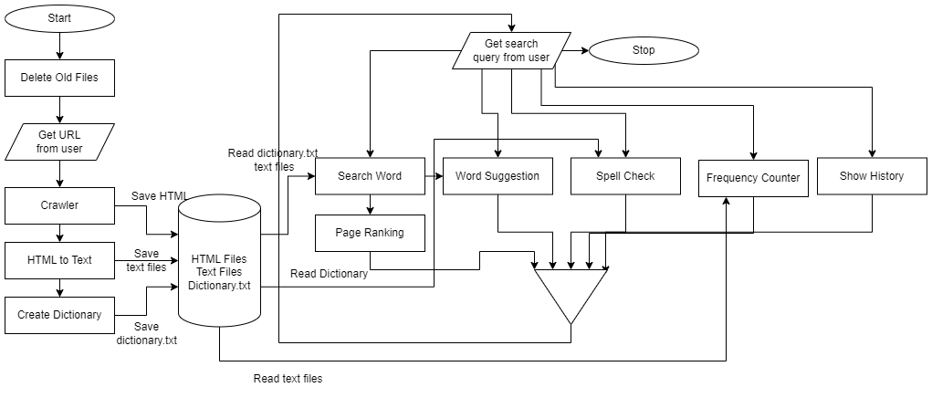
Flowchart
4

Slide 5
Web Crawling and Data Extraction
Crawling: Jsoup
Connecting to a website and downloading HTML content
Operating HTML elements, attributes, and text using DOM selectors
Provides various encoding techniques to parse HTML content to text format
URL Validation: Regex
Pattern matching
Helps in validating the URL extracted through Jsoup
Help in avoiding invalid or irrelevant links during the web crawling
Dictionary: Hashset
Unique set of words found on parsing the text files removing stop-words
Saved as .txt file, used in pattern search and spell check features
Implemented using Hashset

Slide 6
Web Crawling and Data Extraction
Validate URL
Validate the URL using regex - "^(https?)://[a-zA-Z0-9+&@#/%?=~_|!:,.;-]*[a-zA-Z0-9+&@#/%=]$”
Connect URL
Connect to the webpage using Jsoup.connect()
Extract Hyperlinks
Extract all the hyperlinks from the webpage by finding all href tags
Add to Queue
Add the hyperlinks to the queue.
Save HTML files
Save the webpage as HTML file
Convert HTML to Text
Convert the HTML content to text using Jsoup.parse() using US_ASCII encoding.
Save Text files
Save the extracted text in a text file.
Repeat until Queue
Repeat the steps 1-6 for all the elements in the queue or until max crawling limit is reached.
Create Dictionary
Iterate through all the text files and add the words in a hashset while removing the stop-words like the, she, it, then, etc.
Save Dictionary
Save the hashset in the form of text file which is used by other features.

Slide 7
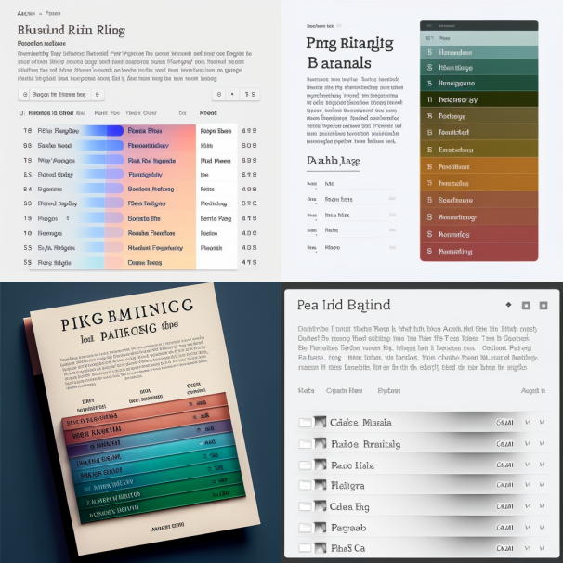
Search Word and Page Ranking

Slide 8
Pattern Searching
Usage of regular Expression using Java in build and optimized class Pattern.
Ranking of the URL frequency List
Sorting done on the basis of priority queue.
HashTable
To store result for the search pattern in the crawled files for a particular URL.

Slide 9
Search Word and Page Ranking
Retrieve Dictionary
Search Word
If word is present
If the word isn’t found in the crawled pages
If the word is found in the crawled pages
For the word being searched, collect the list of URIs and the associated frequencies in a Set.
Display the Set in a tabular format.
Inputs the file from the dictionary build while crawling the page.
Looks up for the search query in the dictionary.
If word doesn’t exist
provide suggestions for similar words.
search for the word in the crawled pages.
Provide suggestions for similar words.

Slide 10
Pattern Matching
INPUT files from directory
Matching pattern and counting it in each File associated to that URI
Returning the List of (count, URL) .
Parsing all the crawled files for a particular URI that are encapsulated within this directory and storing them.
Looping over the crawled files and searching for the pattern as well as storing the count of the given pattern in each URI respectively.

Slide 11

Spell Checking
Spell checking is an essential task in web search engine that involves identifying and correcting spelling errors in text.
One of the most popular algorithms used for spell checking is the Edit Distance Algorithm, which measures the similarity between two words based on the number of operations required to transform one word into another.

Slide 12
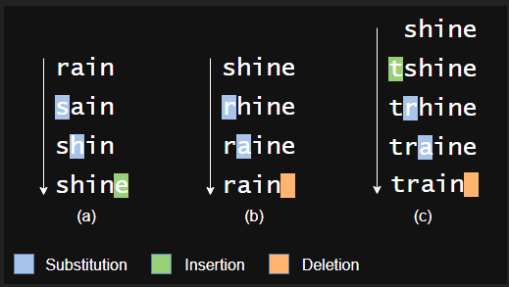
In the example, we can convert the word rain to shine and shine to train in 3 operations (either by substitution, insertion or deletion)
A lower distance implies greater similarity between the two words
Reference : https://devopedia.org/levenshtein-distance

Slide 13

Word Suggestion
Word suggestion is a feature that helps users to correct their spelling errors. Ternary Search Tree (TST) is a data structure that can be used to implement spell suggestion efficiently.

Slide 14
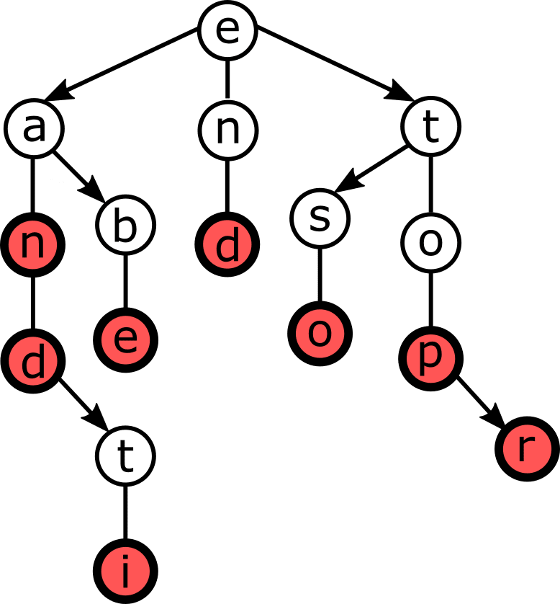
Ternary Search Tree
Ternary Search Tree (TST) is a tree-based data structure that is used to store and retrieve strings efficiently. Unlike other tree structures like Binary Search Tree (BST), TST nodes have three children instead of two: left, equal, and right.
Implementation - We first build a TST from a dictionary of words. Each node in the TST represents a prefix of one or more words in the dictionary. We used the TST to search for a given word and suggest some words that share the same prefix.

Slide 15
FREQUENCY COUNTER
This functionality involves searching frequency of a particular word in the collection set of websites visited by the crawler
Performing a frequency count of words in the collected text can provide valuable insights into the themes and topics covered by the website
Frequency counts can also be used to identify trends and patterns over time. By comparing frequency counts for different time periods, we can see how the themes and topics covered by a website are evolving.

Slide 16
Implementation
The implementation first creates a File object for the "TextFiles" directory and lists all the files in the directory using the listFiles method.
For each file, the program reads the file's content using a ‘FileInputStream’, which reads bytes from the file, and an ‘InputStreamReader’, which converts the bytes to characters using the UTF-8 character encoding.
It then creates a ‘BufferedReader’, which reads the characters from the ‘InputStreamReader’ line by line, converts each line to lowercase, and appends it to a StringBuffer.
Finally, it compiles a regular expression pattern object using the word to be searches
Increment is made to the word count as a match is found

Slide 17

STORING HISTORY
Access to the history in a web search engine is a vital feature that allows users to keep track of their past searches.
Implementation of priority queue and HashMap was done in order to acquire this functionality.
Priority queue is a data structure that stores elements in a particular order based on their priority
Hashmap is another data structure that is useful for organizing historical data. It allows for fast retrieval of information by mapping keys to values.

Slide 18
WORKING
Implementation uses a HashMap to store the frequency count of each search query and a
PriorityQueue is used to maintain the most frequent search queries.
Implementation of a lambda expression was made to sort the search queries by their frequency count.
The class also uses the getOrDefault() method of the HashMap to retrieve the frequency count of a search query and set it to 0 if it does not exist in the HashMap.

Slide 19
THANK YOU

